Slide 1
Supply Chain Management Project
-Nikhil Shimpi

Slide 2
Libraries Used
Numpy
Pandas
Seaborn
Matplotlib
Sklearn
XGBoost
CatBoost

Slide 3
Data Insights - HeatMap
No 2 independent variable are highly correlated with each other. So there is no issue of Multicollinearity.
Storage_issue_reported_l3m variable is highly correlated with target variable product_wg_ton.
Correlation value is 0.99. This implies that Storage_issue_reported_l3m variable alone sufficiently used to build model
Wh_breakdown_l3m is correlated (0.34) with target variable

Slide 4
Data Insights - BoxPlot
Boxplots shows that we don’t have any outliers present in dataset.
We can see few outliers but they are all categorical data.
Worker_no and retail_shop_no have some outliers but We can consider them as valid ones.

Slide 5
Data Insights – ScatterPlots and Histogram
Scatterplot of storage_issue_reported_l3m with target variable shows the nearly linear relationship.
Histogram of retail_shop_num shows nearly normal distribution
Histogram of worker_num shows nearly somewhat right skewed distribution

Slide 6
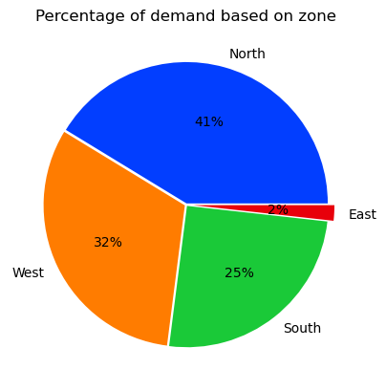
Data Insights - PieCharts
Piechart of % demand based on zone shows – company need to improvise in east zone
Only 2% demand coming up from east zone
Highest demand 41% is in north zone

Slide 7
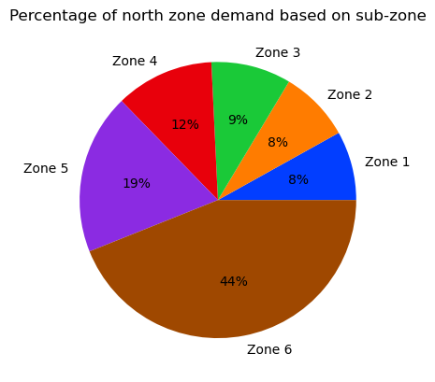
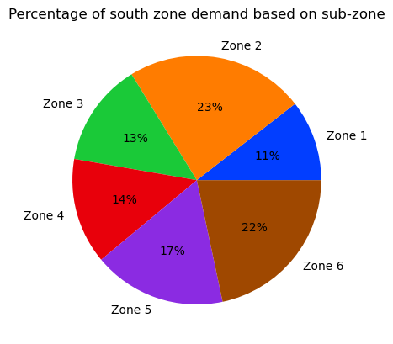
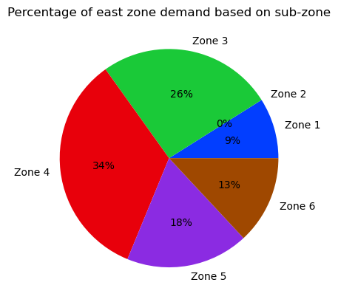
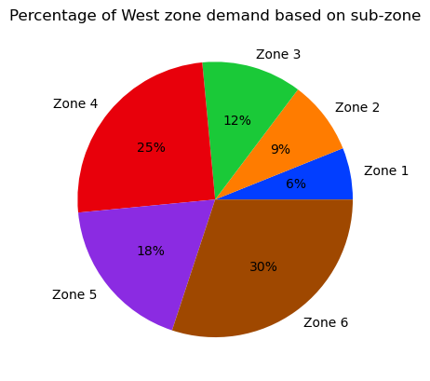
Data Insights - PieCharts

Slide 8
Data Imputation and Preprocessing
Ware_house_ID and WH_Manager_ID colomns have all unique values which are not required for analysis. So removed from dataset.
wh_est_year variable have 47.5% null values. So, removed from dataset.
workers_num colomn have 3.96% null values. Imputed using mean.
approved_wh_govt_certificate colomn have 3.63% null values. Imputed using mode.
WH_regional_zone colomn converted to numerical colomn.
['Location_type', 'WH_capacty_size', 'zone', 'wh_owner_type', 'approved_wh_govt_certificate'] colomns are one hot encoded
Standard scaler used for all variables to standardize them.

Slide 9
Models Used
"Linear Regression": LinearRegression(),
"Lasso": Lasso(),
"Ridge": Ridge(),
"K-Neighbors Regressor": KNeighborsRegressor(),
"Decision Tree Regressor": DecisionTreeRegressor(),
"Random Forest Regressor": RandomForestRegressor(),
"XGB Regressor": XGBRegressor(),
"CatBoosting Regressor": CatBoostRegressor(verbose=False),
"Ada Boost Regressor": AdaBoostRegressor()

Slide 10
Results
Model Name | R2 Score on Test data
Linear Regression | 0.984583
Lasso | 0.984585
Ridge | 0.984584
K-Neighbors Regressor | 0.684107
Decision Tree Regressor | 0.986795
Random Forest Regressor | 0.992880
XGB Regressor | 0.992818
CatBoosting Regressor | 0.993340
Ada Boost Regressor | 0.974766

Slide 11
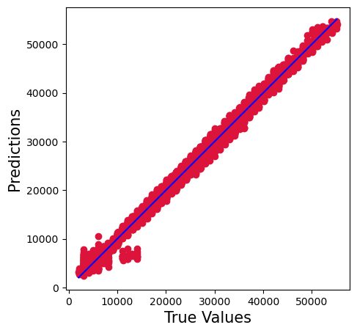
Best Model
CatBoosting Regressor
Model performance of Training set
- Root mean square error: 740.8231385048789
- Mean absolute error: 569.5301238223302
- R2 score: 0.99593982311005
-----------------------------------------------
Model performance of Test set
- Root mean square error: 943.5296632858445
- Mean absolute error: 697.5642406848858
- R2 score: 0.9933400288602948

